Slide 1

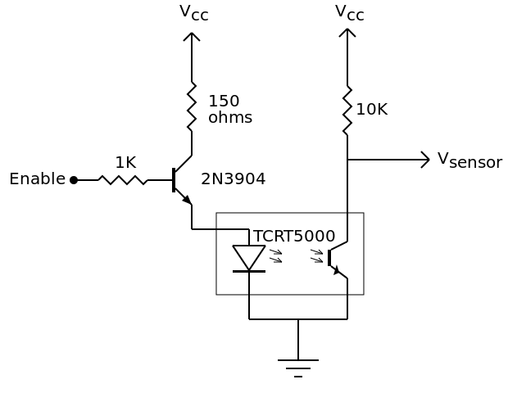
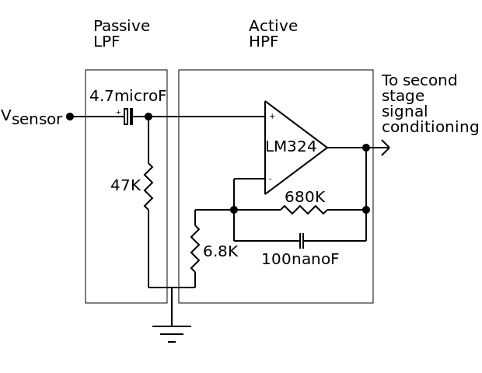
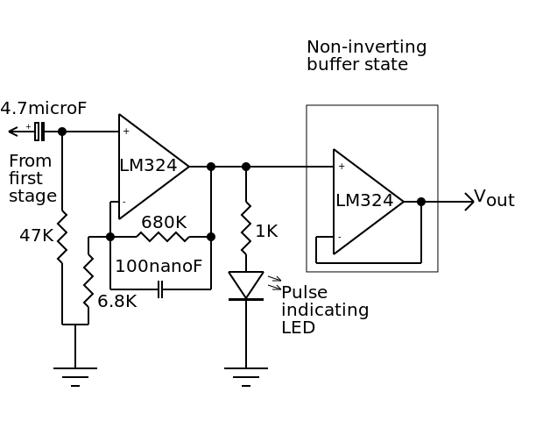
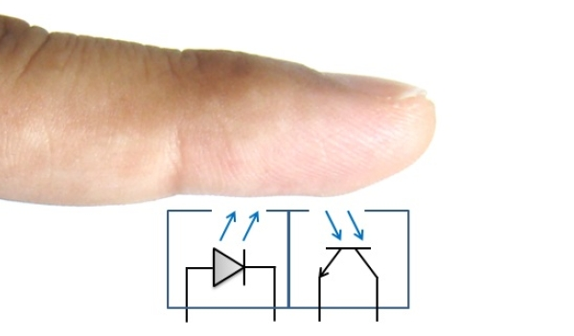
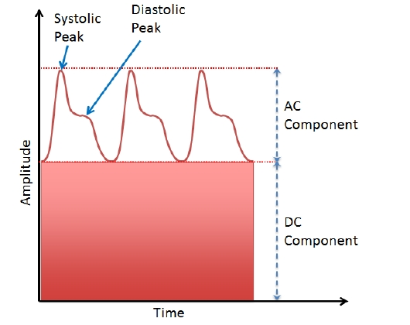
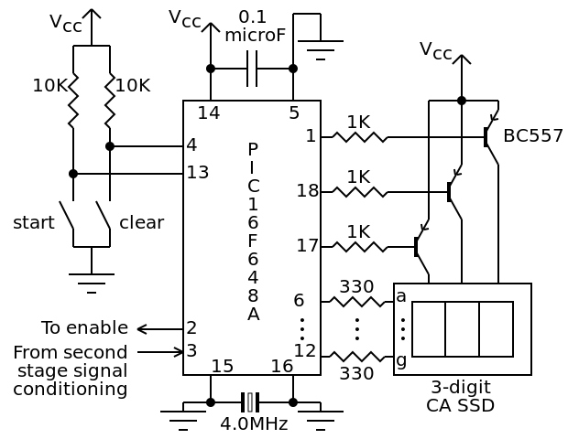
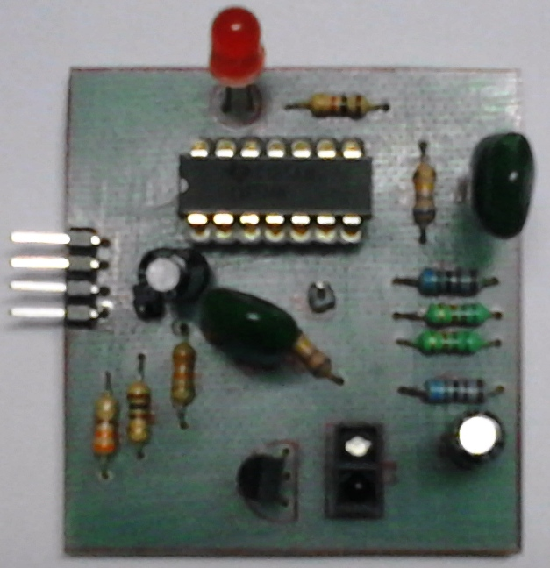
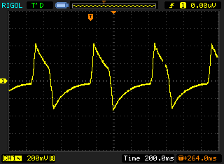
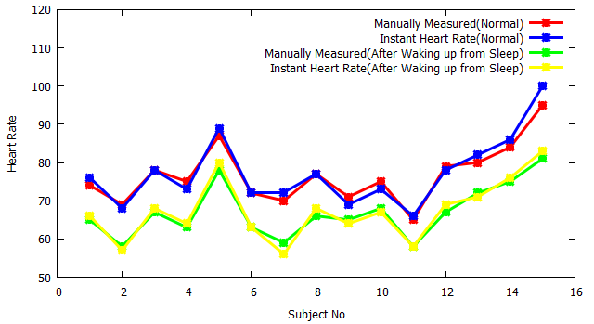
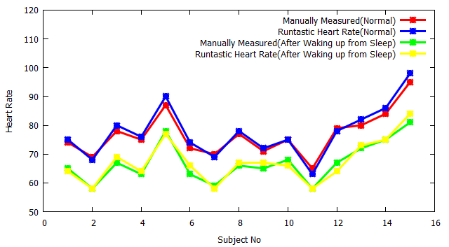
Photoplethysmographic Analysis of Optical Signals:
A Single Device to Measure All the Vital Signs
Nazmus Saquib (0905020), Md. Tarikul Islam Papon (0905001),
Ishtiyaque Ahmad (0905013)
I. Introduction
IV. Circuit Construction
Four vital signs indicate a person’s essential body functions:
    Heart rate
    Blood pressure
    Respiratory rate
    Body Temperature
External Biasing Circuit
  This part of the circuit provides reading from a sensor (TCRT1000, TCRT5000, and LTH1550-01) to detect change in volume of blood.
II. Objective
First Stage of Signal Conditioning
  This stage of the circuit removes the DC component of PPG signal using a
  high pass filter and it also amplifies the AC component by a factor of 101.
  An active low pass filter having a cutoff frequency of 2.34 Hertz is used to
  boost the AC component.
  Constructing a device to measure heart rate, respiratory rate, blood pressure and oxygen saturation level in blood that is
  Cost-effective
  Noninvasive
  Simple and efficient
  Possible to interface with computers
  One major objective is to measure these using only Smart Phones.
Second Stage of Signal Conditioning
  The second stage of signal conditioning is actually a clone of the first
  stage. This stage also provides a gain of 101, resulting in final gain of 10201.
III. Background
  Photoplethysmography (PPG) is the volumetric measurement
  of an organ through optical means, resulting from fluctuations
  in the amount of blood or air it contains.
First Stage
Second Stage
Interfacing to Microcontrollers and PCB design
V. Output
T1
Interfacing to μC
PCB design
VII. Smart Phone Applications
  Smartphone applications can measure Heart Rate and respiratory rate accurately.
T₂
Output PPG Signal from Oscilloscope
  The peaks of the PPG signal indicates one heart beat.
  Accuracy for heart rate measurement is found to be about 97%
Comparison between two smart phone applications measuring Heart Rate
VI. Blood Pressure Measurement
  Theoretically, it is possible to measure Blood Pressure using only Smart Phones.
  (Yet there isn’t any!!! )
  Blood pressure is strongly related to Pulse Travel Time (PTT)
  Formula for measuring Blood pressure follows :
  P_{sys} = [k₁ × (C_{dx})²] + k₂
  P_{dis} = [k₃ × (C_{dx})²] + [k_{HR} × HR] + k₄
  C_{dx} is related to ECG Signal and PPG signal which is strongly
  related to T₁ and T₂.
  We derived a formula and take some measurements which
  produced very promising results.
VIII. Conclusion and Future Work
We are still working on measuring the blood pressure accurately.
As a future improvement, the device can be used to measure heart rate and blood
pressure remotely. A software can be developed to aid the process of data
visualization. Data logging can be a nice addition to keep record of heart rates.
Studies have shown that PPG can also be used to measure peripheral capillary
oxygen saturation and respiratory rate. An attempt can be taken to devise a single
module having all four features.
Department of Computer Science and Engineering (CSE), BUET

